Slide 1

WeatherWare
Be Weather Aware

Slide 2
TOC
Overview
Problem
Solution
Business Model Canvas
Competition
Competitive Advantages
Extensions
References

Slide 3
Overview
Aim to help users prepare for the day’s weather
Provide user with advice on recommended clothing, sunscreen factor and water volume for the day
Accessible to anyone with a browser

Slide 4
Problem
Hypothermia, heatstroke and dehydration are all serious illnesses that can be caused by simple exposure
Less serious conditions can also be mitigated by being more proactive in staying healthy
In July alone 150,000 people reported heat rash to their local GP according to the NHS

Slide 5
Solution
Accessible website giving location based advice
Real time up to date information
Global coverage

Slide 6
Business Model Canvas
openweather
map
Cloudways Web Hosting
Advertising
Server upkeep
Inform preparation for day trips including water intake, sunscreen factor and appropriate clothing
Automated services
Marketed to adults with children or elderly dependents, and for personal use
Key
Partners
Key
Activities
Value
Proposition
Customer
Relationships
Customer
Segments
Server Time
Weather data
Targeted adverts
Feedback email
Key
Resources
Channels
Openweathermap service $40/month, Cloudways service $10/month
Advertising clothing, nearby restaurants, grocery stores, and camping supplies
Cost Structure
Revenue Streams

Slide 7
Competition
dressbyweather.com
Dailydressme.com
sunsmart.com
QSun app
Sunscreenr Mobile
Water Drink Reminder

Slide 8
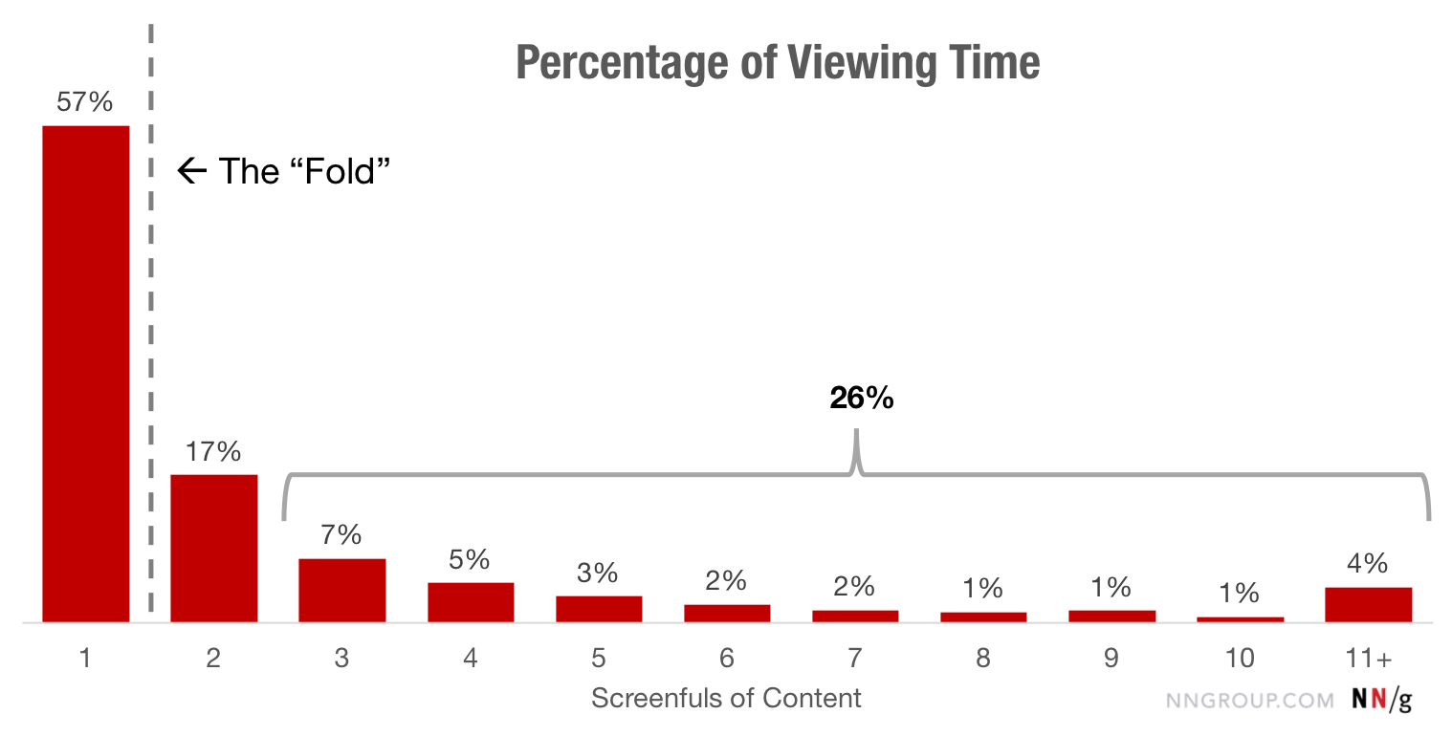
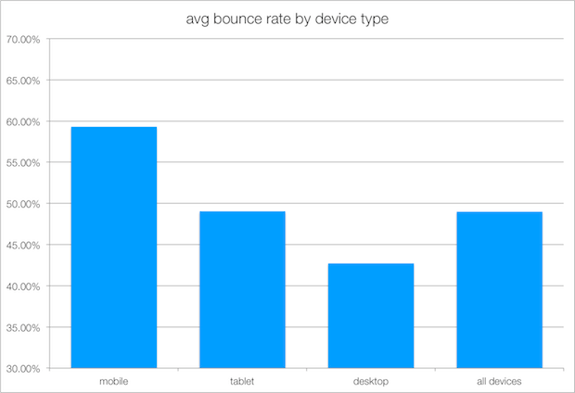
Competitive advantages of our product ws1ws

Slide 9
Extensions
Implement adverts
Make app version with daily notifications
Varying water intake for different intensity of exercise and humidity
Allow users to register, and make profiles for more specific recommendations
Recommended maximum exposure time
Account for environments increasing sunburn risk
Use device location for finding weather data
Store the day’s weather data for faster website response times
Collect user data which can be sold on to other companies

Slide 10
References
Heat rash statistic:
https://www.england.nhs.uk/2019/07/nhs-top-tips-for-families-to-stay-safe-as-heatwave-marks-start-of-school-holidays/
Bounce rate statistic and diagram:
https://www.gorocketfuel.com/the-rocket-blog/whats-the-average-bounce-rate-in-google-analytics/

